Slide 1
Robot Drawings
Elad Siman Tov
Shai Rothbard

Slide 2
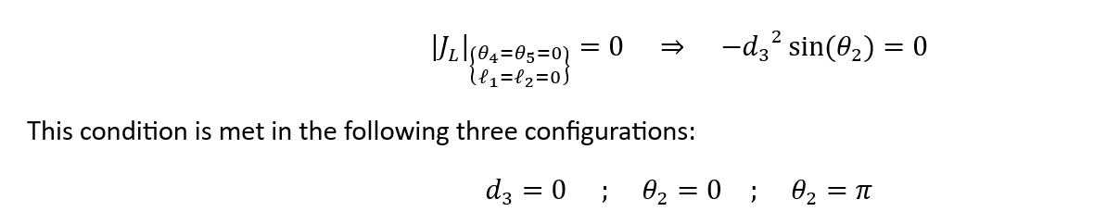
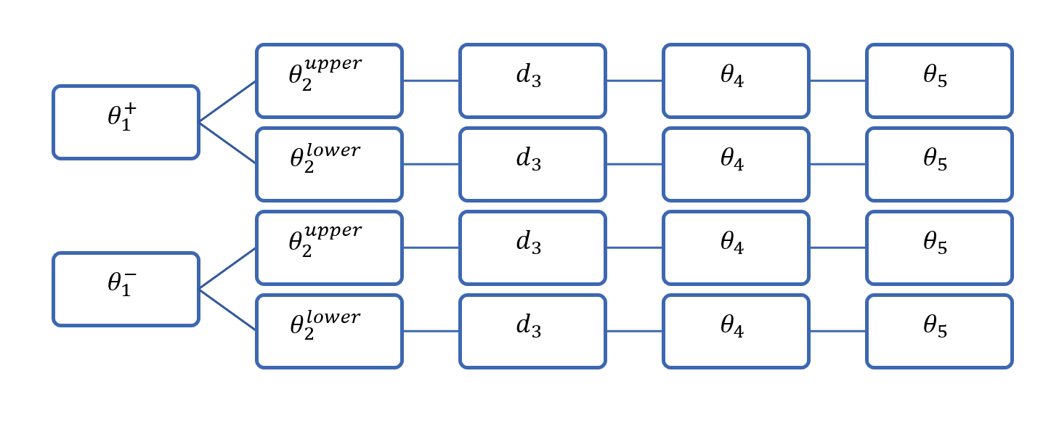
Things to draw
Inverse Kinematics Solutions
Singular States.

Slide 3




















$$θ_{5}$$
$$θ_{5}$$
$$θ_{5}$$
$$θ_{5}$$
$$θ_{4}$$
$$θ_{4}$$
$$θ_{4}$$
$$θ_{4}$$
$$d_{3}$$
$$d_{3}$$
$$d_{3}$$
$$d_{3}$$
$$θ_{2}^{upper}$$
$$θ_{2}^{upper}$$
$$θ_{2}^{lower}$$
$$θ_{2}^{lower}$$
$$θ_{1}^{−}$$
$$θ_{1}^{−}$$
$$θ_{1}^{+}$$
$$θ_{1}^{+}$$

Slide 4
$$θ_{5}$$
$$θ_{5}$$
$$θ_{5}$$
$$θ_{5}$$
$$θ_{4}$$
$$θ_{4}$$
$$θ_{4}$$
$$θ_{4}$$
$$d_{3}$$
$$d_{3}$$
$$d_{3}$$
$$d_{3}$$
$$θ_{2}^{upper}$$
$$θ_{2}^{upper}$$
$$θ_{2}^{lower}$$
$$θ_{2}^{lower}$$
$$θ_{1}^{−}$$
$$θ_{1}^{−}$$
$$θ_{1}^{+}$$
$$θ_{1}^{+}$$

Slide 5

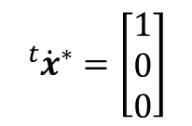

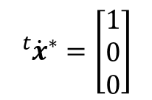
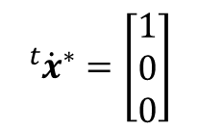

$${}_{ }^{t}{{\dot{x}}^{∗}}=\left[\begin{aligned}1 \\ 0 \\ 0\end{aligned}\right]$$
$${}_{ }^{t}{{\dot{x}}^{∗}}=\left[\begin{aligned}1 \\ 0 \\ 0\end{aligned}\right]$$
$${}_{ }^{t}{{\dot{x}}^{∗}}=\left[\begin{aligned}1 \\ 0 \\ 0\end{aligned}\right]$$
$$θ_{2}=π$$
$$θ_{2}=0$$
$$d_{3}=0$$

Slide 6
